Slide 1
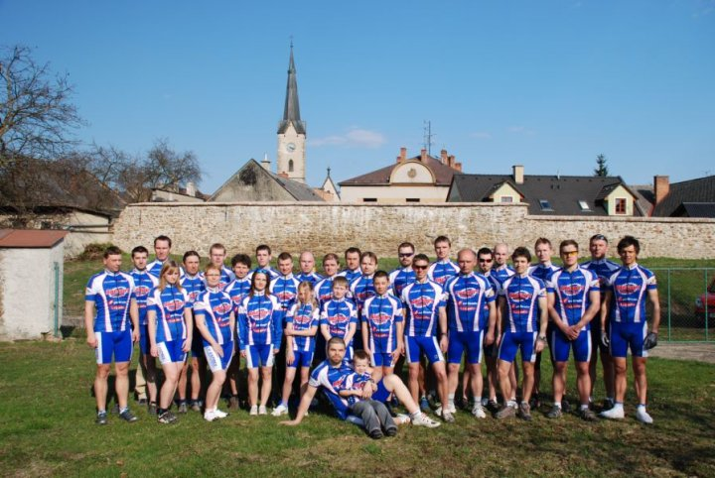
Cycling

Slide 2
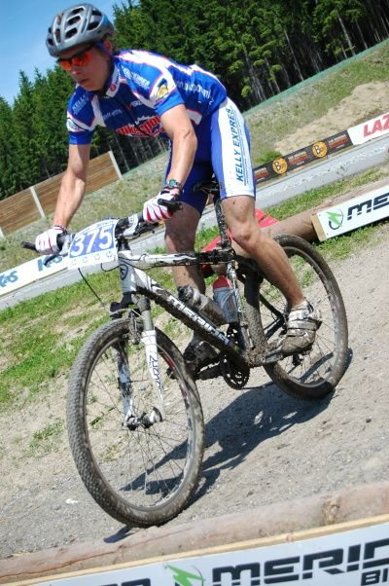
MTB – Cross country, Marathon,
Road cycling

Slide 3
Cross country
Is the most common discipline of mountain biking.
It is a Olympic discipline.
It is a circuit around 6km.

Slide 4
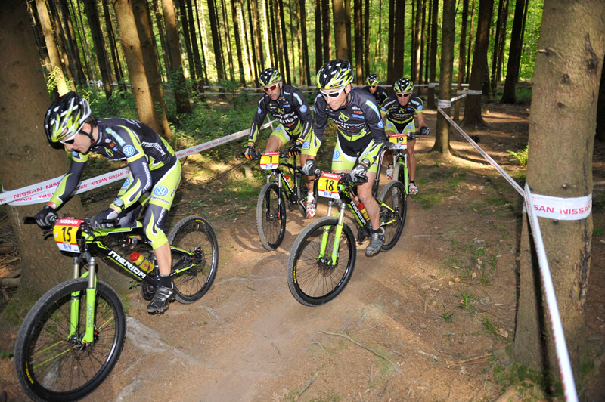
Marathon
It is toughets discipline in MTB racing.
It is between 60 km and 120 km.

Slide 5
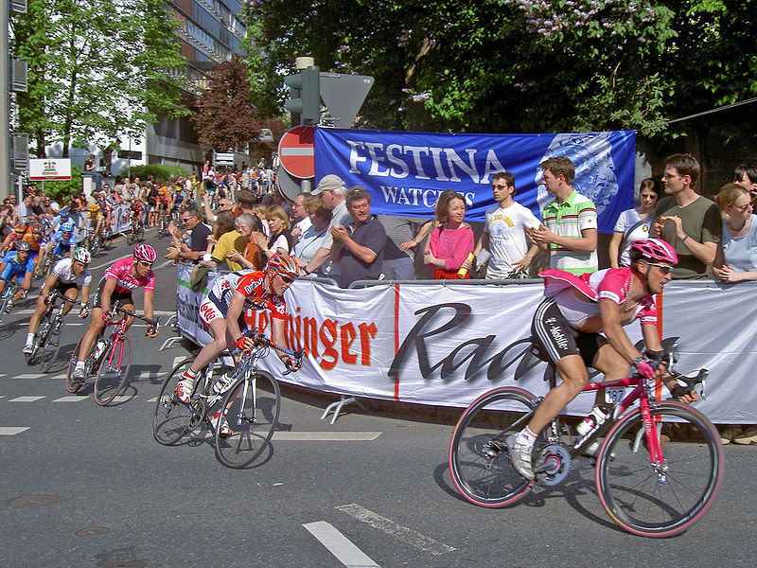
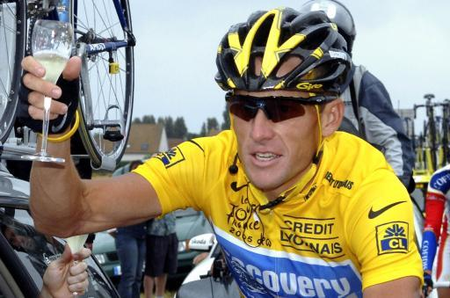
Road cycling
It is on road.
Tour de France
Every race is about 180km.
Lance Armstrong won 7 times Tour.

Slide 6
The end ☺

