Slide 1
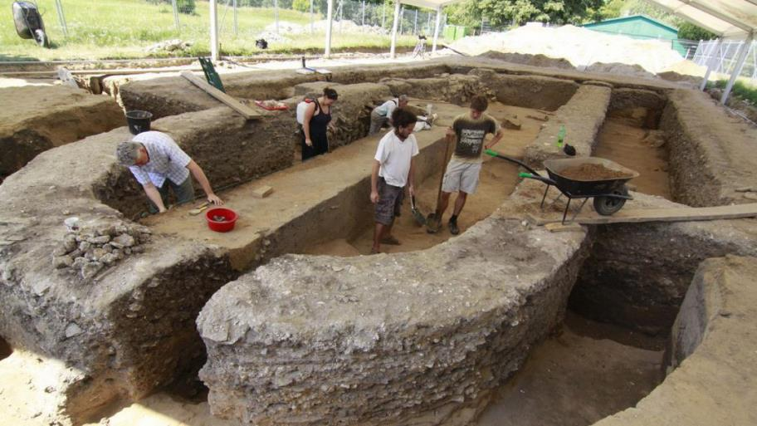
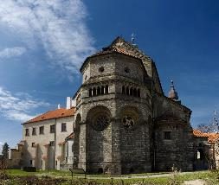
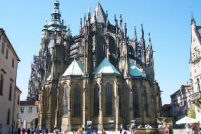
Architecture in Czechia
pre-Romanesque architecture
Gothic
Romanesque architecture
9 century – 10 century
11 century – half of the 13 century
half of the 13 century– end of 15 century
Timeline

Slide 2
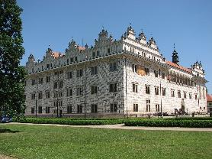
Architecture in Czechia
Romanesque architecture
pre-Romanesque architecture
Gothic
Rennaissance
9 century – 10 century
11 century – half of the 13 century
half of the 13 century– end of 15 century
turn of the 15 and 16 century – beginning of 17 century
Timeline

Slide 3
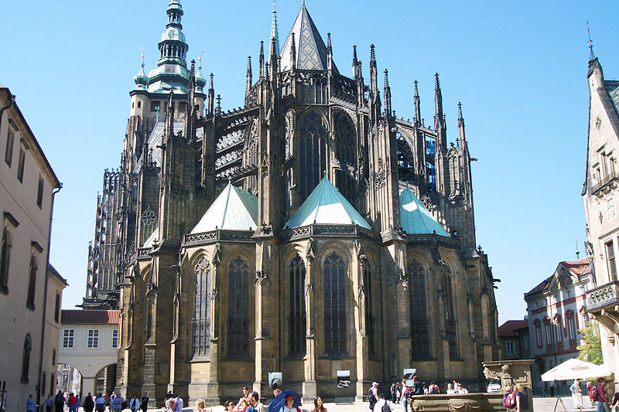
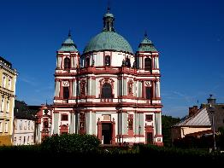
Architecture in Czechia
Gothic
Romanesque architecture
Rennaissance
Baroque
11 century – half of the 13 century
half of the 13 century– end of 15 century
turn of the 15 and 16 century – beginning of 17 century
beginning 17 century–end 18 century
Timeline

Slide 4
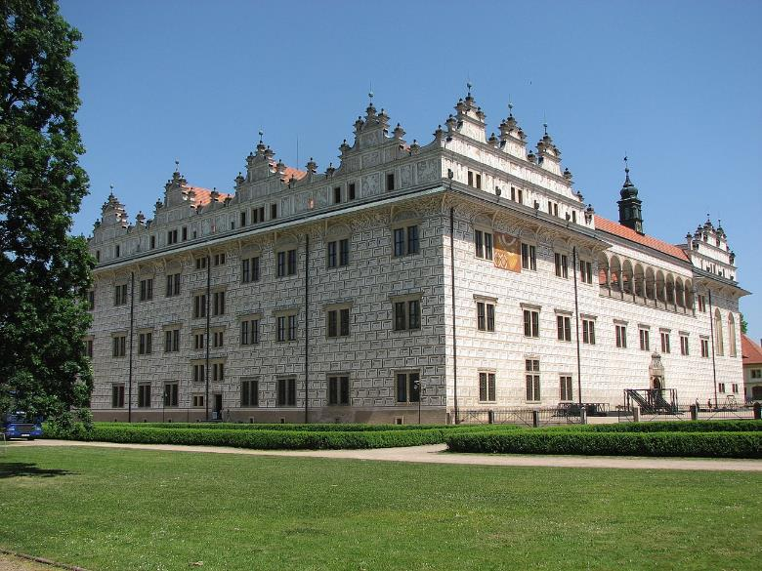
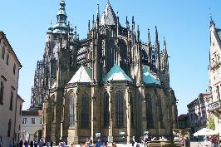
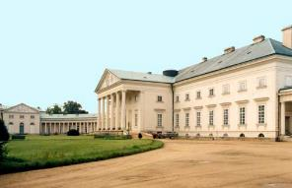
Architecture in Czechia
Rennaissance
Gothic
Baroque
Neo-clacissicism and Romantism
half of the 13 century– end of 15 century
turn of the 15 and 16 century – beginning of 17 century
beginning 17 century–end 18 century
end of 18 century – end of 19 century
Timeline

Slide 5
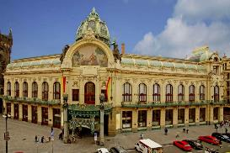
Architecture in Czechia
Baroque
Rennaissance
Neo-clacissicism and Romantism
Art-Nouveau
beginning 17 century–end 18 century
end of 19 century –cca 1910
turn of the 15 and 16 century – beginning of 17 century
end of 18 century – end of 19 century
Timeline

Slide 6
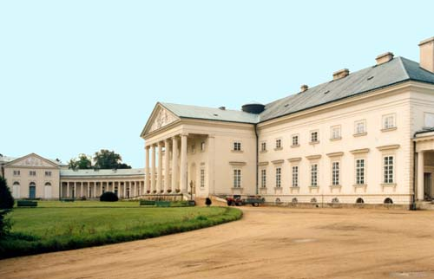
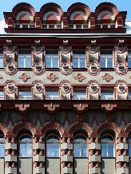
Architecture in Czechia
Neo-clacissicism and Romantism
Baroque
Art-Nouveau
Czech Cubism and Rondocubism
beginning 17 century–end 18 century
end of 18 century – end of 19 century
end of 19 century –cca 1910
cca 1910 – 1920s
Timeline

Slide 7
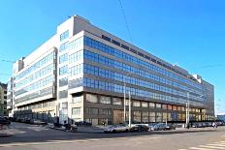
Architecture in Czechia
Art-Nouveau
Functionalism
Neo-clacissicism and Romantism
Czech Cubism and Rondocubism
end of 18 century – end of 19 century
end of 19 century –cca 1910
cca 1910 – 1920s
1920s – end of 1930s
Timeline

Slide 8
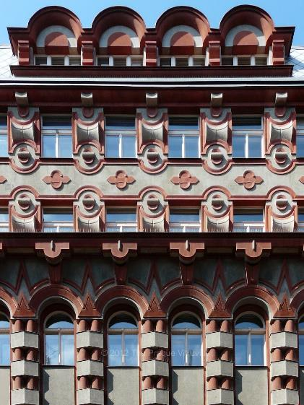
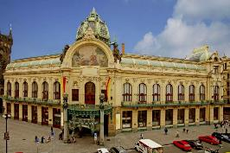
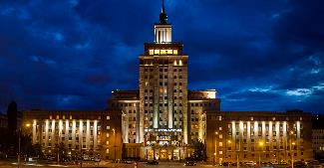
Architecture in Czechia
Czech Cubism and Rondocubism
Art-Nouveau
Functionalism
Socialist Realism
end of 19 century –cca 1910
cca 1910 – 1920s
1920s – end of 1930s
cca 1950–end of 1980s
Timeline

Slide 9
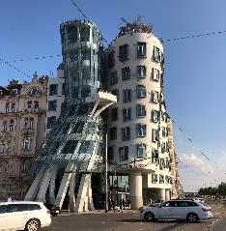
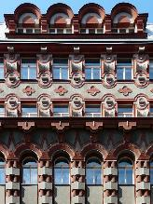
Architecture in Czechia
Functionalism
Postmodern architecture
Czech Cubism and Rondocubism
Socialist Realism
cca 1910 – 1920s
1920s – end of 1930s
cca 1950–end of 1980s
cca 1990–now
Timeline

Slide 10
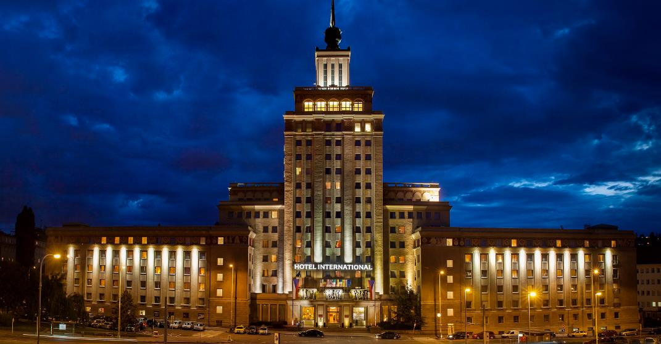
Architecture in Czechia
Postmodern architecture
Socialist Realism
Functionalism
1920s – end of 1930s
cca 1950–end of 1980s
cca 1990–now
Timeline

Slide 11
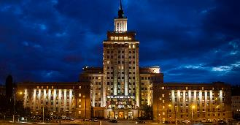
Architecture in Czechia
Postmodern architecture
Socialist Realism
cca 1950–end of 1980s
cca 1990–now
Timeline

