Slide 1
ArcHitectural styles in Czechia

Slide 2
Index:
Romanesque architecture
Gothic
Renaissance
Baroque
Neo-classicism and Romantism
Art-Nouveau
Czech Cubism and Rondocubism
Functionalism
Socialist Realism
Postmodern architecture

Slide 3
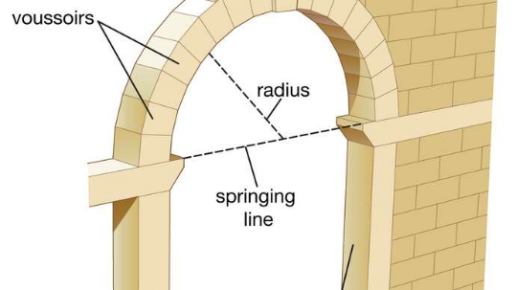
Romanesque architecture
Period:10 century – half of the 13 century
Main features: Roman semi-circular arch, very thick walls, dressed stone, groin vaults (for arcades, barrel vaults (for roofs), arcades, large towers, west-facing entry, large murals
types of vault
semi-circular arch

Slide 4
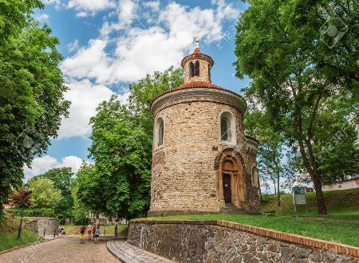
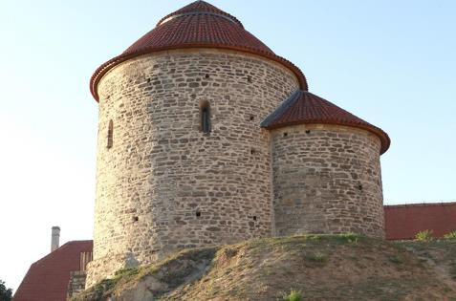
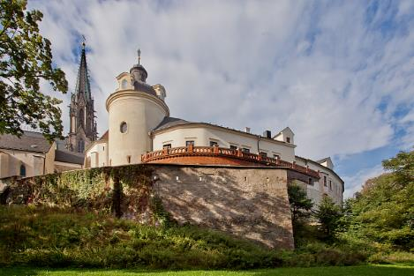
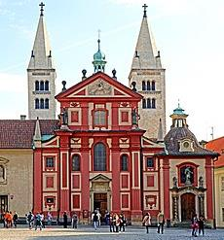
Examples of Romanesque buildings in Czechia
Rotunda of St. Martin in Prague
Rotunda of St. Catherine in Znojmo
The Přemyslid Palace in Olomouc,
St. George Basilica in Prague

Slide 5
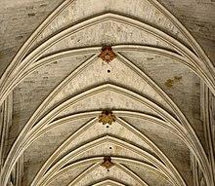
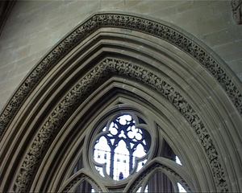
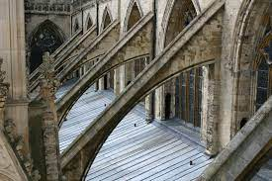
Gothic architecture
Period: half of the 13 century– end of 15 century
Early Gothic – Přemyslid Gothic (13th and early 14th century)
High Gothic – Luxembourg Gothic (14th and early 15th century)
Late Gothic – Jagiellonian Gothic (approximately 1471–1526)
Main features: rib vault , pointed arch, clustered columns, large windows, verticality, external buttresses
rib vault
pointed arch
external butteresse

Slide 6
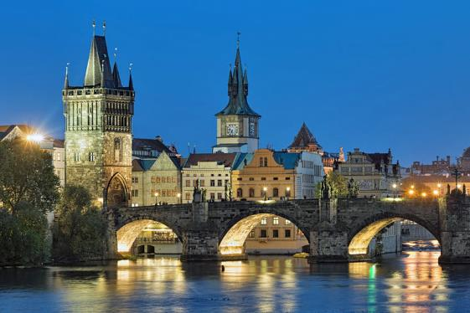
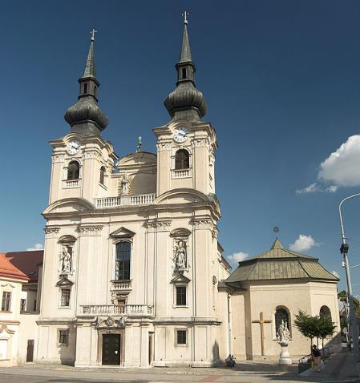
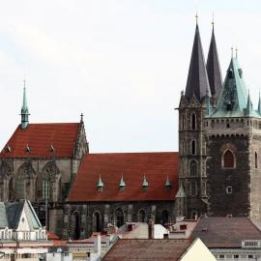
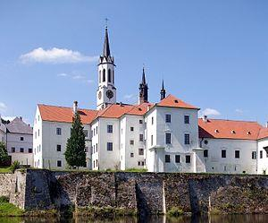
Examples of Gothic buildings in Czechia
Charles Bridge in Prague
Church of the Assumption of the Virgin Mary in Brno
Church of St. Bartholomew in Kolín
Church of Vyšší Brod Monastery

Slide 7
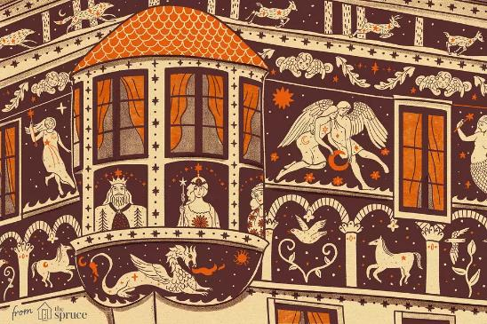
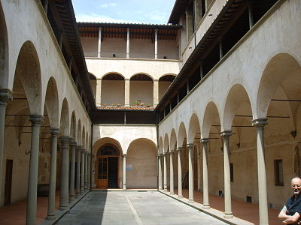
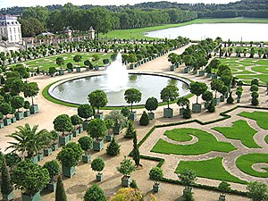
Rennaissance
Period: turn of the 15 and 16 century – beginning of 17 century, periods: Jagiellonian period, Habsburg period
Main features: sgraffito (figural or ornamental) facade, big rectangular windows, arcade courtyards, geometrically arranged gardens with fountains and statues, antique collumns
sgraffito
arcade courtyards
geometrically arranged gardens with fountains and statues

Slide 8
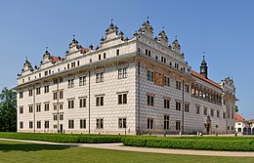
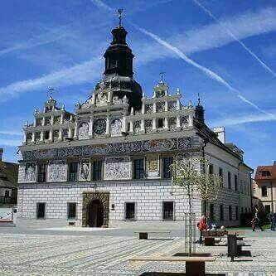
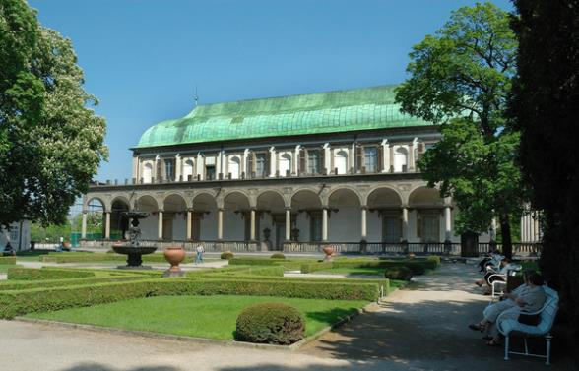
Examples of Rennaissance in Czechia
Chateau Litomyšl
Royal Summer Palace in the Royal Garden of Prague Castle
Town Hall in Stříbro

Slide 9
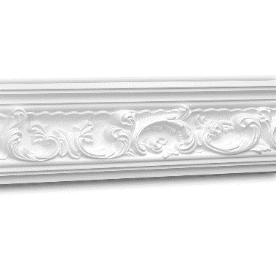
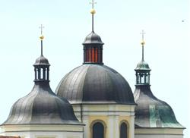
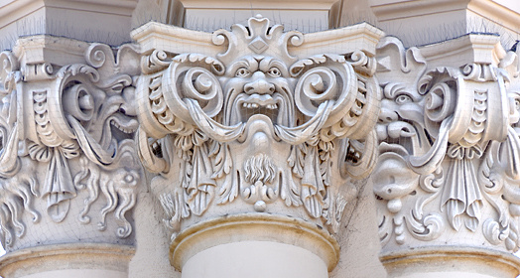
Baroque
Period: beginning 17 century – end of 18 century
Main features: domes, facades with massive central adornments, asymetrical facades, illusory decoration as general art, ceilings heavily stuccoed or frescoed, emphasis on colour and light both internally and externally, external moldings and figures (stucco or covered wood)
domes
stucco decoration
external molding

Slide 10
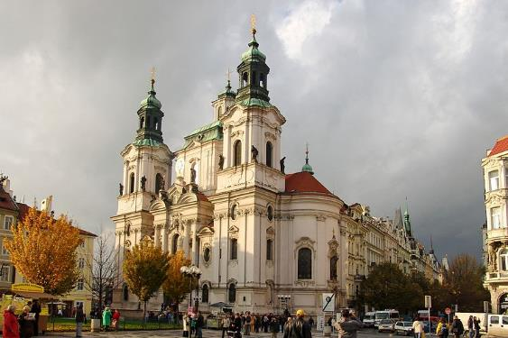
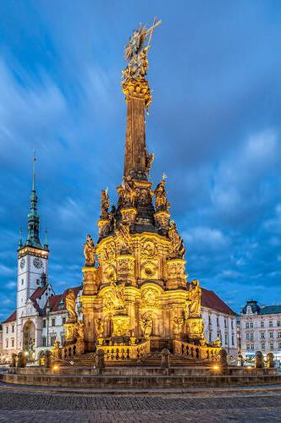
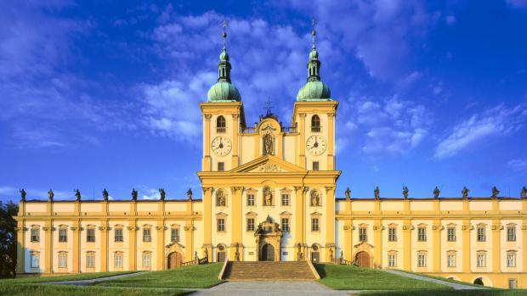
Examples of Baroque buildings in Czechia
St. Nicholas Church in Prague
Church of Visitation of Virgin Mary – Olomouc - Sv. Kopeček
Holy Trinity Column in Olomouc

Slide 11
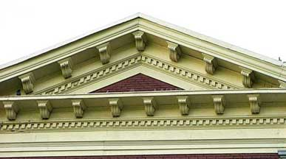
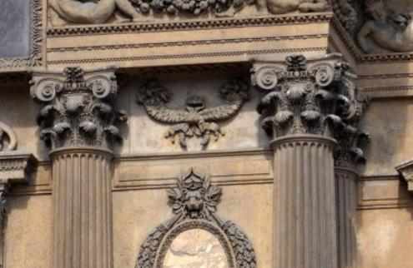
Neo-clacissicism and Romantism
Period: end of 18 century – end of 19 century
Features: triangular pediments, columns and pilasters with clacissist ornaments, inspiration by ancient Greek and Roman architecture, emphasis on symetry and regularity
triangular pediments
columns and pilasters with clacissist ornaments

Slide 12
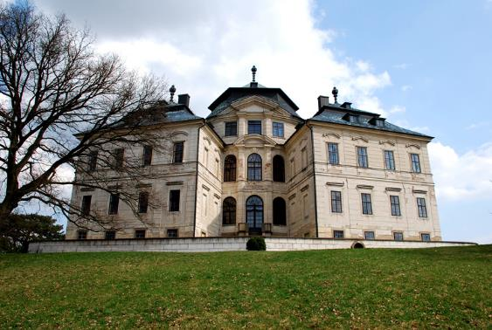
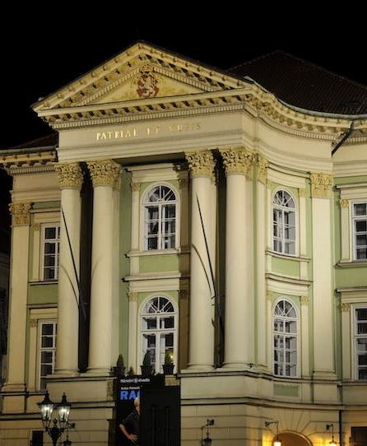
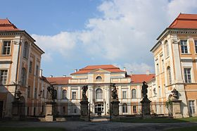
Examples of neo-Clacissicism buildings in Czechia
Karlova Koruna Chateau in Chlumec nad Cidlinou
Stavovské Theatre in Prague
Duchcov Chateau

Slide 13
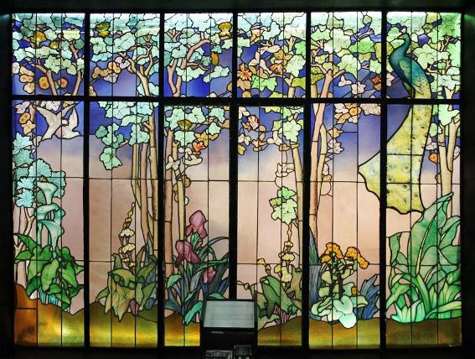
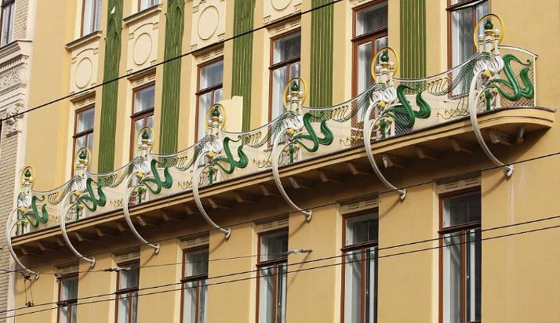
Art-Nouveau
Period: end of 19 century – cca 1910
Main features: organic decorative features - trees, flowers, branches/vines and fruit (apples, pears and grapes), decorated facades and balconies, the emphasis on the line (zigzag extended curve), curved forms, lightness, light, space and apparent weightlessness, elegance, freedom
organic decorative feature
decorated facade and balcony

Slide 14
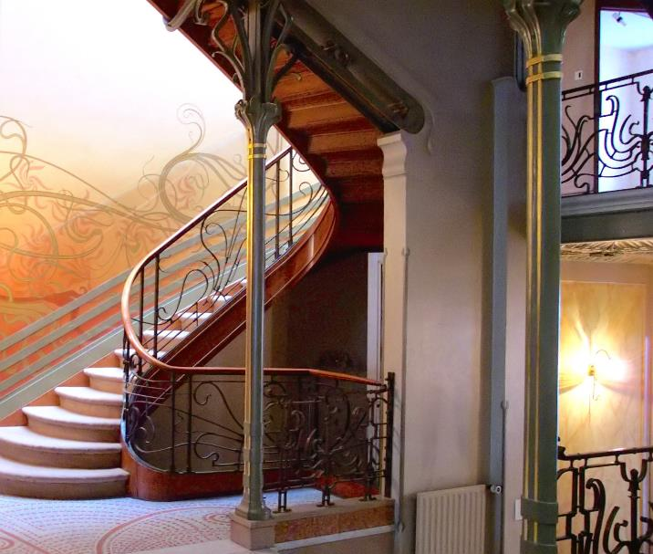
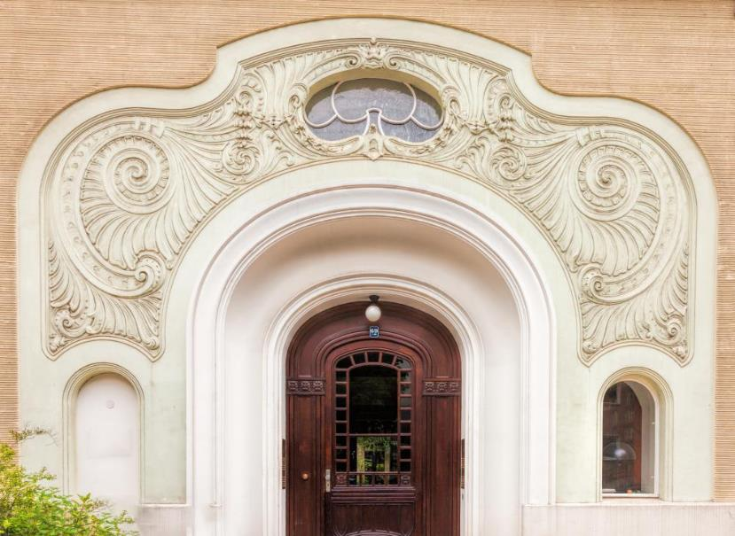
the emphasis on the line
curved forms

Slide 15
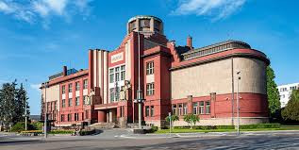
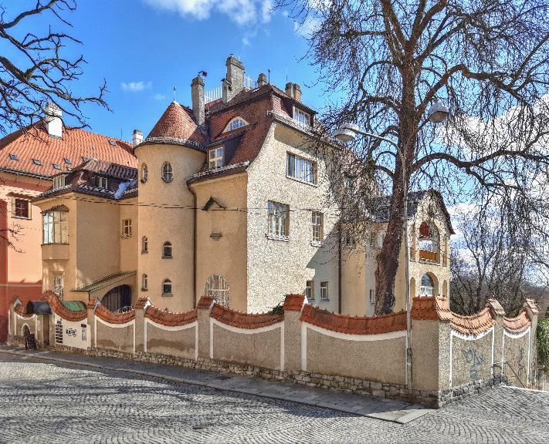
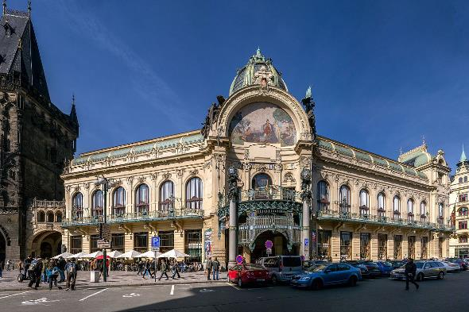
Examples of Art-Nouveau buildings
East Bohemian Museum in Hradec Králové
Villa Primavesi in Olomouc
Municipal House in Prague

Slide 16
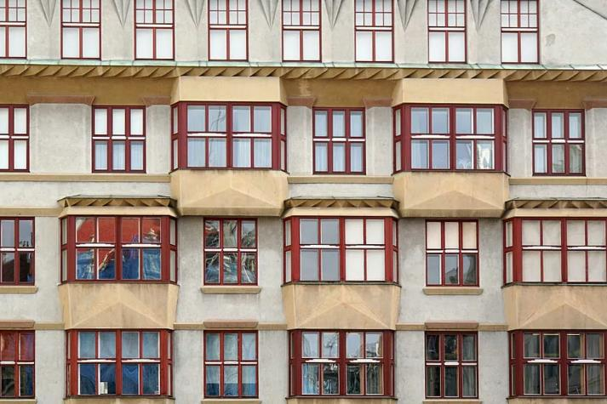
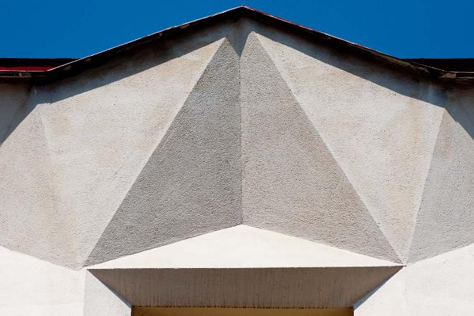
Czech Cubism and Rondocubism
Period: cca 1910 – 1920s
Main features: sharp edges, geometrical patterns, intersecting planes, crystalline structures
sharp edges
crystalline pattern

Slide 17
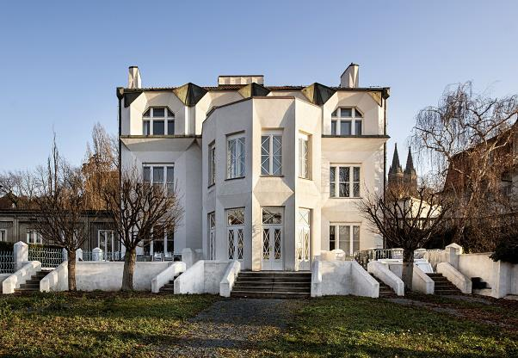
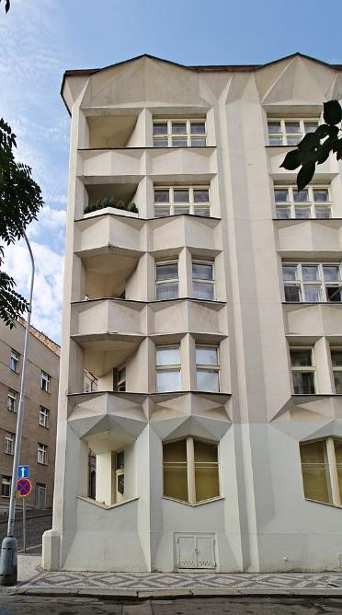
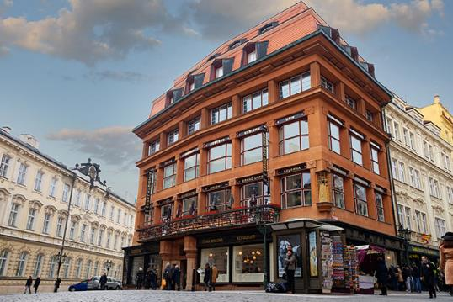
Examples of Czech Cubism and Rondocubism buildings
Kovařovic Villa in Prague
the residential house on Neklanova Street in Prague
House of The Black Madonna in Prague

Slide 18
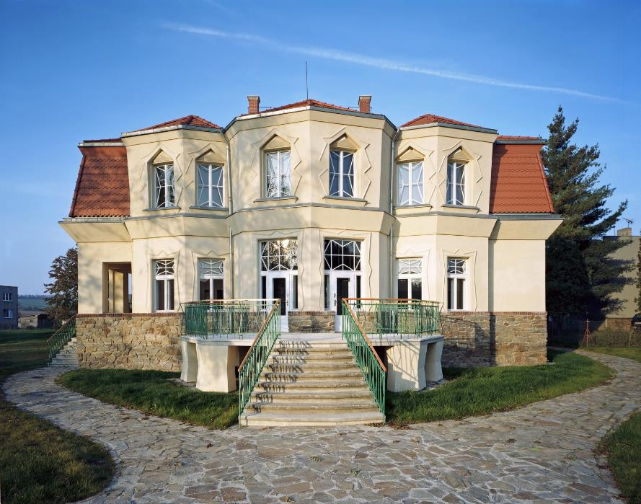
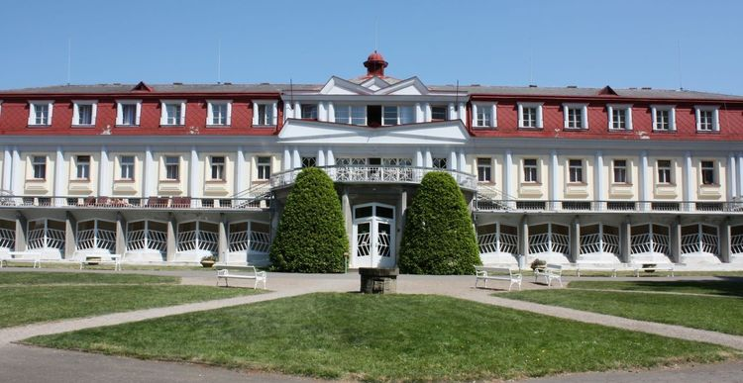
Thermal Baths in Bohdaneč
Bauer Villa in Libodřice

Slide 19
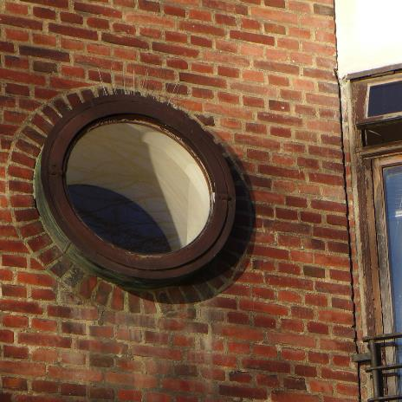
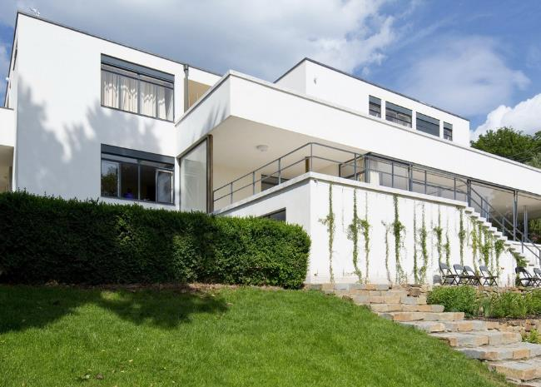
Functionalism
Period: 1920s – end of 1930s
Main features: emphasis on the purpose and function, round windows, flat roofs, low levels of ornamentation and decoration, flat concrete slabs, steel sheets, and even wood beams
round windows
flat roofs

Slide 20
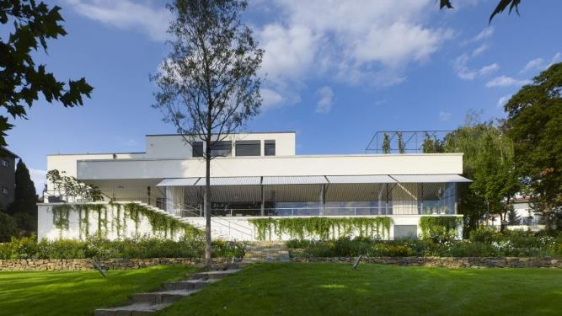
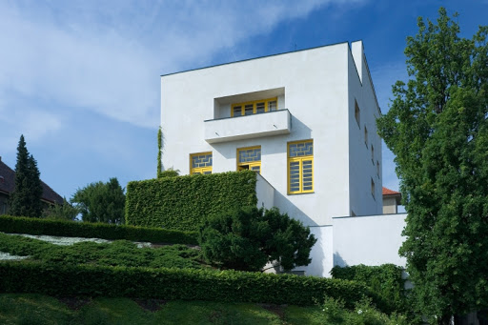
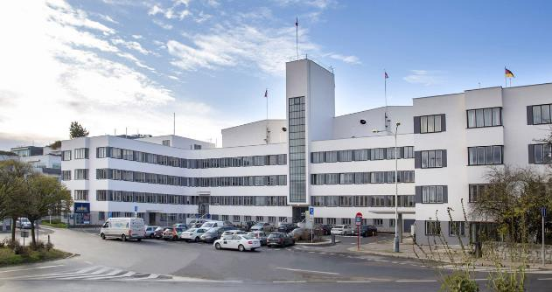
Examples of functional buildings
Villa Tugendhat in Brno
Müller´s Villa in Prague
Barrandov Film Studios in Prague

Slide 21
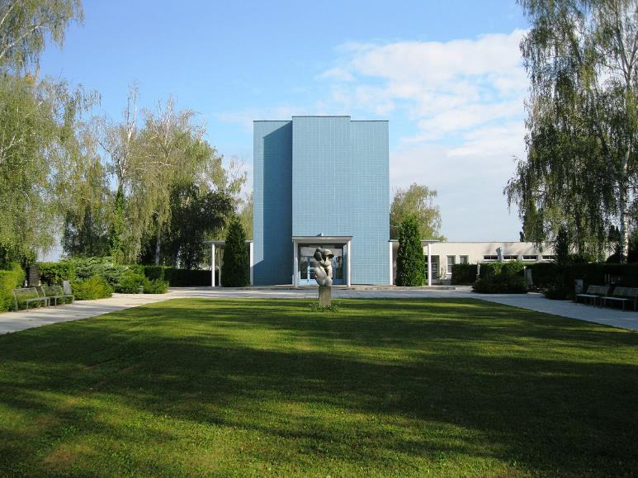
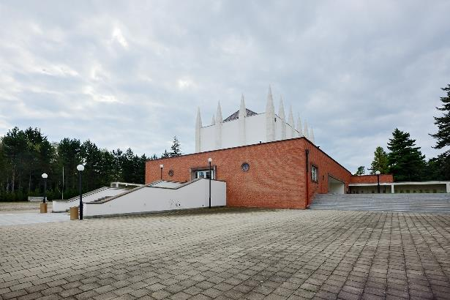
Brno Crematorium
Olomouc Crematorium
Tomáš Baťa Memorial in Zlín

Slide 22
Socialist Realism (Sorela)
Period: cca 1950 – end of 1980s
Main features: uniform look, perpendicular streets and rectangular squares, blocks of flats of the same height and form, Classicist columns and triangular or stepped gables, historicising elements on the facades of buildings, national motifs
streets and squares form a regular pattern full of right angles
typical block of flats

Slide 23
Examples of Socialist Realism buildings
Hotel International in Prague
Hotel Thermal in Karlovy Vary

Slide 24
National Museum in Prague
astronomical clock in Olomouc

Slide 25
Postmodern architecture
Period: cca 1990 – now
Features: curved forms, decorative elements, assymetry
curved forms
assymetry

Slide 26
Examples of postmodern architecture
The National Library of Technology in Prague – Dejvice
Dancing House in Prague

Slide 27
Congress Centre in Zlín
Moravian Bussiness College in Olomouc

